Slide 1
CISC106 – i>clicker
A competent programmer should know several correct answers that a program should compute, before writing a single line of code.
True
False

Slide 2
CISC106 – i>clicker
A competent programmer should know several correct answers that a program should compute, before writing a single line of code.
True
False

Slide 3
CISC106 – i>clicker
A doc string for a function should include which of the following?
A description of what the function does.
A description of any parameters the function uses, including their type.
A description of what the function returns, including its type.
All of the above.

Slide 4
CISC106 – i>clicker
A doc string for a function should include which of the following?
A description of what the function does.
A description of any parameters the function uses, including their type.
A description of what the function returns, including its type.
All of the above.

Slide 5
CISC106 – i>clicker
What will be output?
alpha
1.0
2.0
my_function()
An error will occur
def my_function():
alpha = 2.0
return 1.0
print(my_function())

Slide 6
CISC106 – i>clicker
What will be output?
alpha
1.0
2.0
my_function()
An error will occur
def my_function():
alpha = 2.0
return 1.0
print(my_function())

Slide 7
CISC106 – i>clicker
What will be output?
7
7.0
sqrt(49.0)
An error will occur
import math
print(sqrt(49.0))

Slide 8
CISC106 – i>clicker
What will be output?
7
7.0
sqrt(49.0)
An error will occur
import math
print(sqrt(49.0))

Slide 9
CISC106 – i>clicker
What will be output?
6.0
6.25
f(5) // g(3)
6
def f(x):
return x * x
def g(y):
return y + 1
print(f(5) // g(3))

Slide 10
CISC106 – i>clicker
What will be output?
6.0
6.25
f(5) // g(3)
6
def f(x):
return x * x
def g(y):
return y + 1
print(f(5) // g(3))

Slide 12
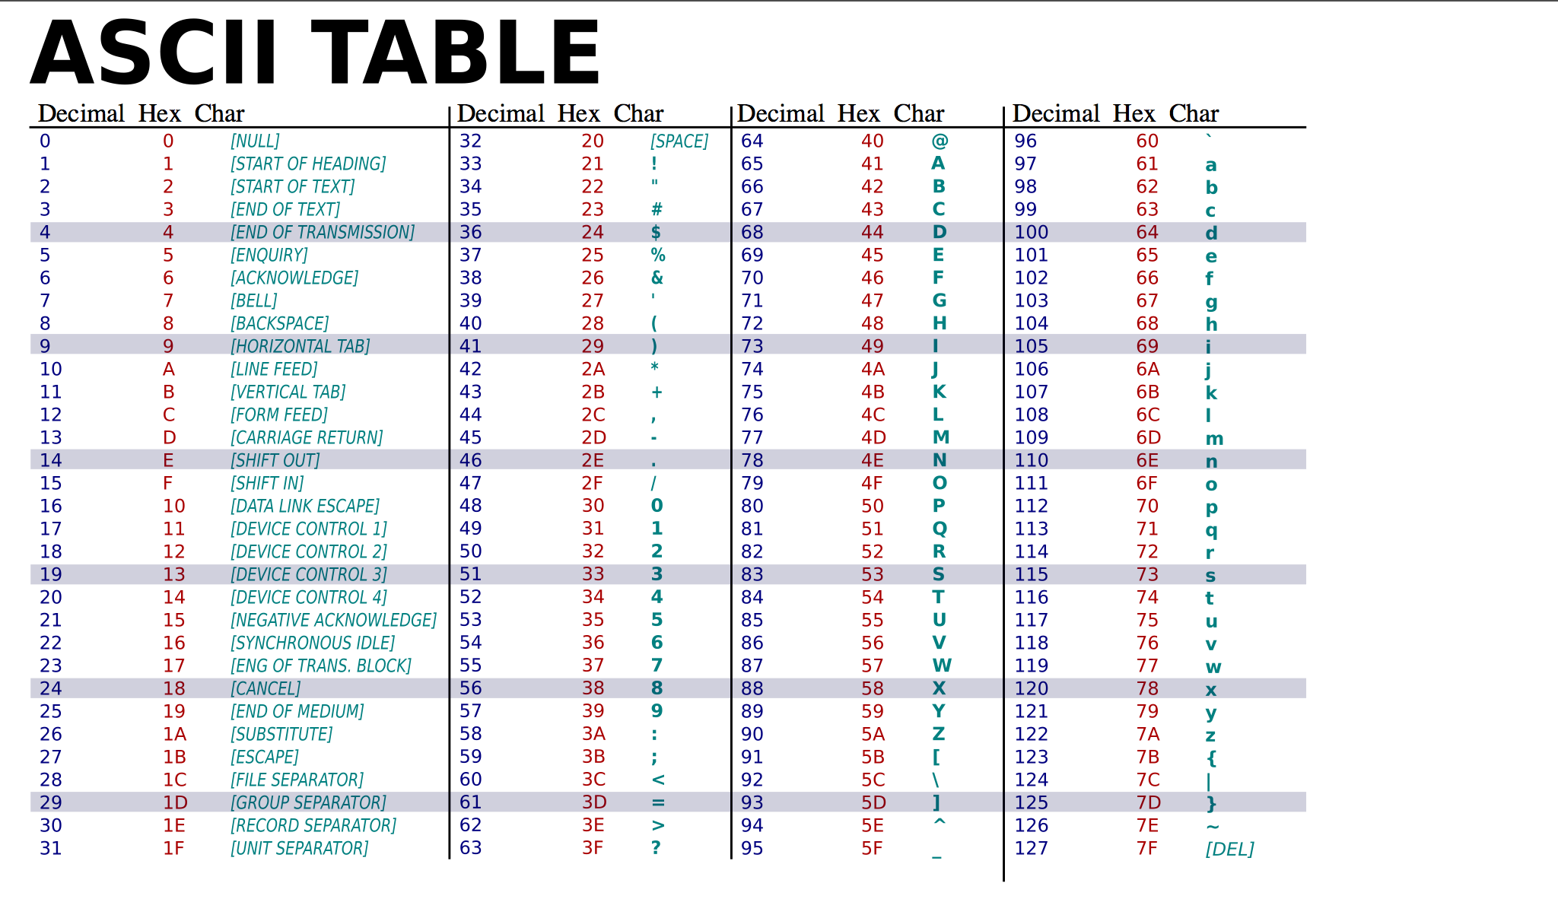

Slide 15
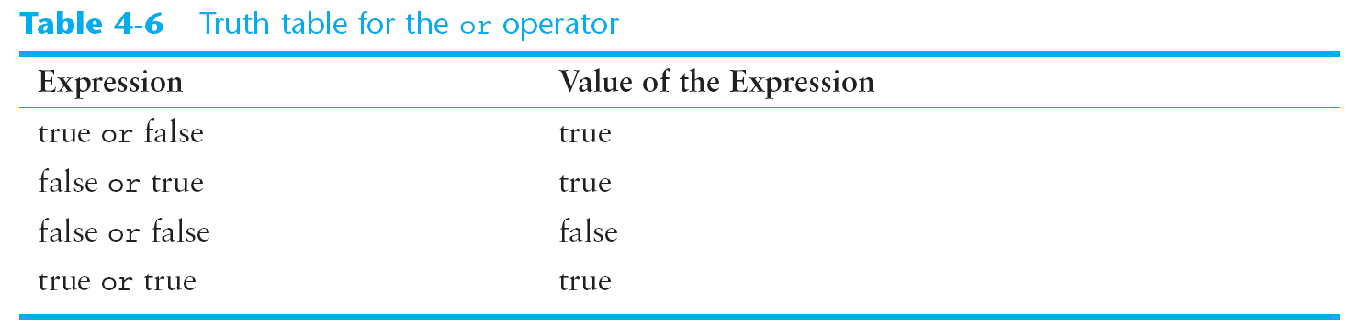

Slide 16
Logical Operator Precedence
not – highest precedence
not False and False = (not False) and False = False
not False and False != not (False and False) = True
and – next highest precedence
True or True and False = True or (True and False) = True
True or True and False!= (True or True) and False = False
or – lowest precedence
not False or True and False = (not False) or (True and False) = True
not False or True and False!= not (False or True) and False
!= False

Slide 17
Logical Operator Associativity
and associativity is left to right
If any of a, b, c or d is False, Python stops evaluation and returns False. Otherwise it returns True.
a and b and c and d
or associativity is left to right
If any of a, b, c or d is True, Python stops evaluation and returns True. Otherwise it returns False.
a or b or c or d

Slide 18
How do we write Python code to print out a grade, given a score?
score | grade
[90, 100] | A
[80, 90) | B
[70, 80) | C
[60, 70) | D
[0, 60) | F
Notation: [ ] vs [ ) vs ( ] vs ( )

Slide 20
if-elif-elif-…-elif-else
if condition:
<python statements>
.
elif condition:
<python statements>
.
.
.
elif condition:
<python statements>
.
else: #<-- optional
<python statements>
.

